Slide 1

Agenda
Java Introduction
What is Java?
What is JDK?
Components of JDK
Java & Eclipse Installation
First Java Program
Variables & Datatypes
Data Operations in Java
Programming Constructs

Slide 2
Java Introduction

Slide 3
Java Introduction
Java is an object-oriented programming language that is used in a distributed environment on the internet.
It is a high-level language that is easy to read and understand.
Java is popularly used in console, GUI, web and mobile applications, game development and to make embedded systems.
Java is also used to develop software for devices
Java is a computer-based programming language invented by James Gosling and Sun Microsystems in 1991.
Java is a platform independent programming language that follows the logic of “Write Once Run Anywhere”

Slide 4
What is Java?

Slide 5
What is Java?
It is a fast , reliable and secure programming language that can be used in several websites and applications
It can be used to create applications in a single computer, or one that could be distributed across servers and clients.
Java can be used in several scenarios, independent of system that it is used on.

Slide 6
Where is Java Used?
Embedded Systems
Web servers and application servers
Enterprise Applications
Scientific applications
Big Data Technologies
Internet Of things (IOT)

Slide 7
How do JVM, JRE and JDK work?

Slide 8
What is JDK?
Java Development Kit (JDK)
JDK is a software development environment which is used to develop Java applications and applets.
JDK consists
Java Runtime Environment (JRE)
Interpreter (JAVA)
Compiler (javac)
Archiver (JAR)
Documentation generator (Javadoc)

Slide 9
Components of JDK
JVM
JRE
JDK
Core classes
Java Runtime Environment
(JRE) → Java RTE
Supporting files
“Minimal requirements to write and compile a Java program”

Slide 10
How do JVM, JRE and JDK work?
Source file
Class Loader: It makes sure that all the necessary classes are loaded in the time of the execution of a program.
Byte code verifier: The BYTE code verifier checks the code for errors or irregularities based on access rights on objects.
Interpreter: While running the program, the interpreter loads, checks and runs the code.
Source file. java
Byte code. class

Slide 11
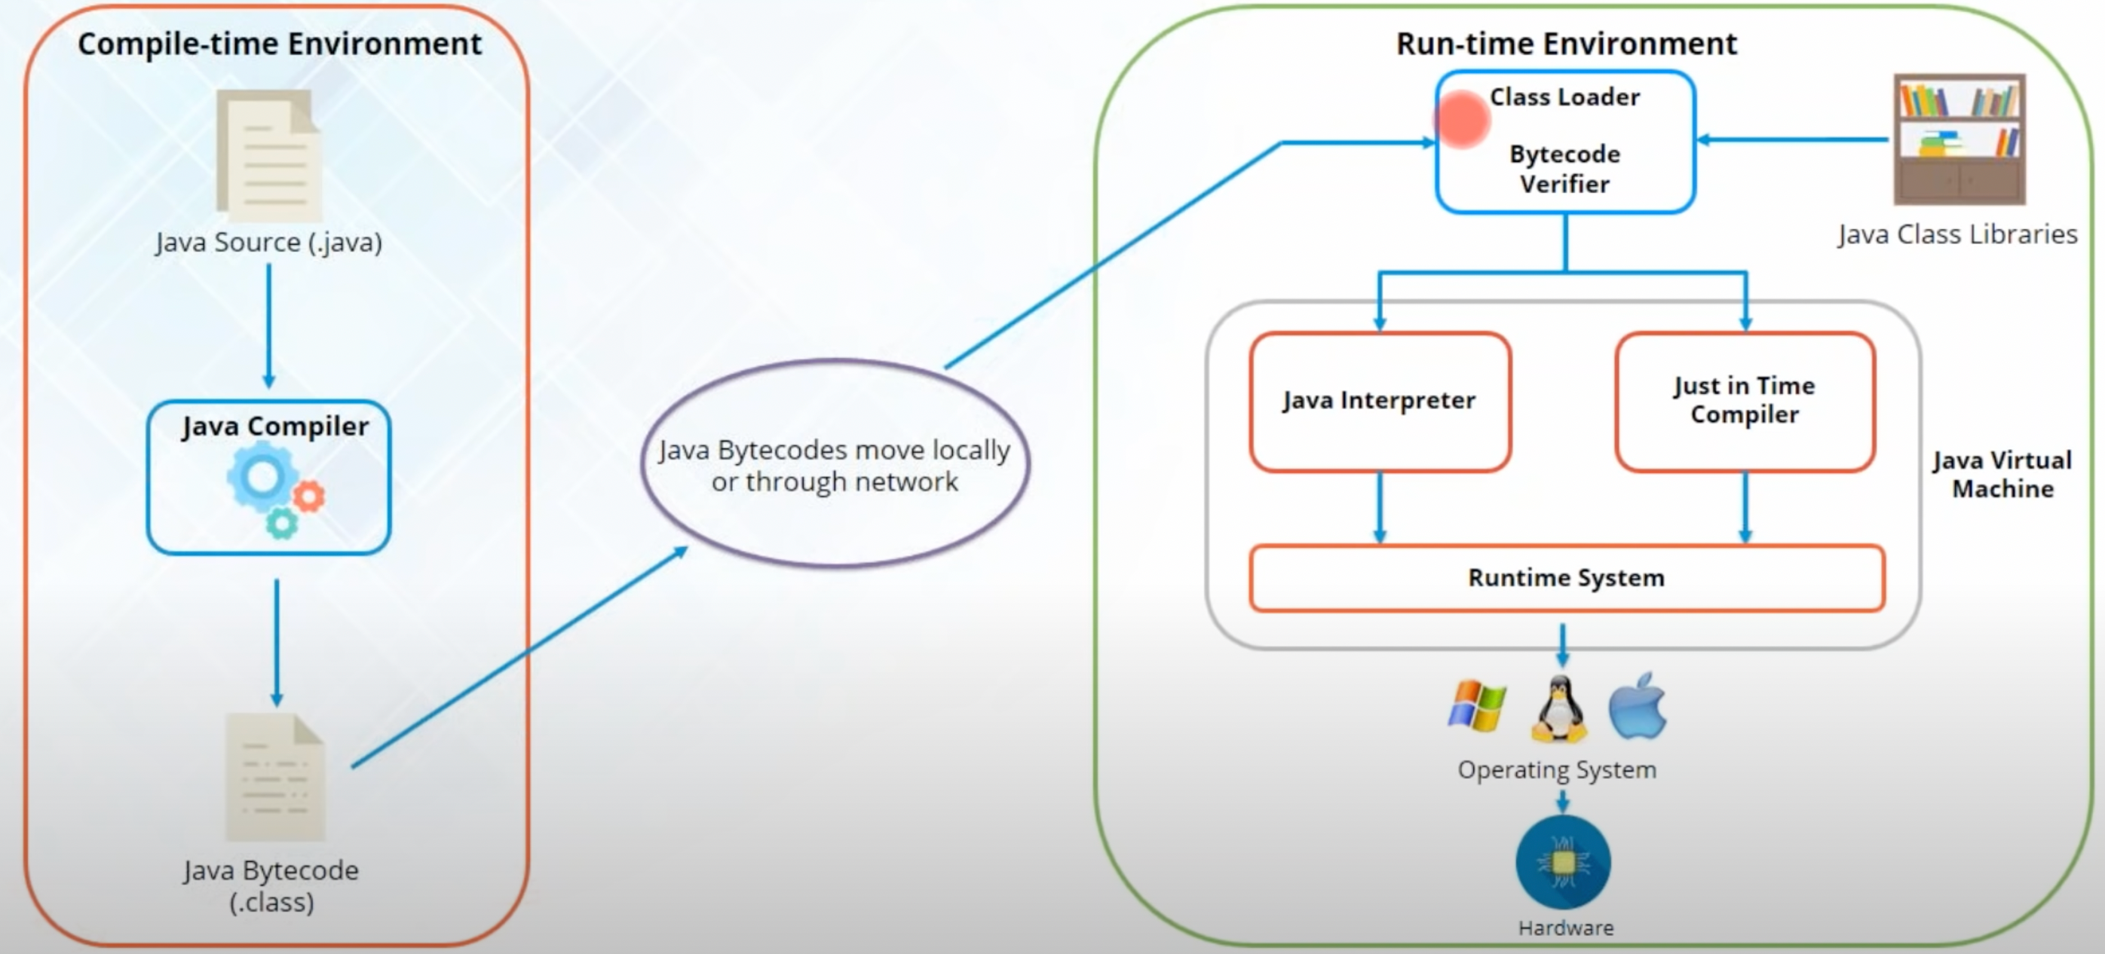
How do JVM, JRE and JDK work?

Slide 12
Java & Eclipse Installation

Slide 13
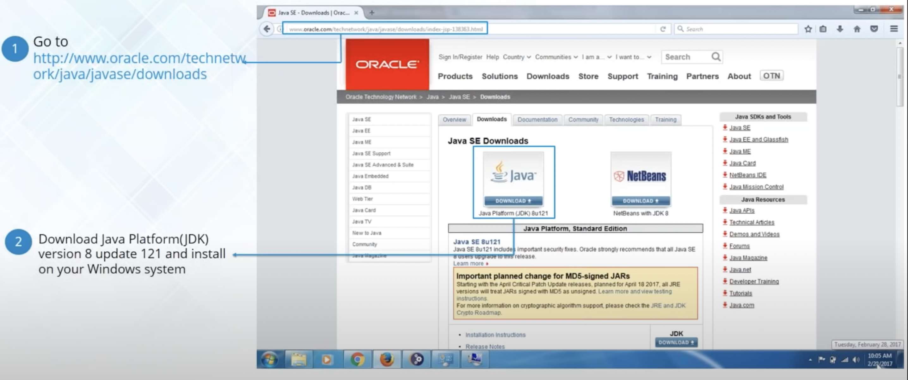
Java Installation

Slide 14
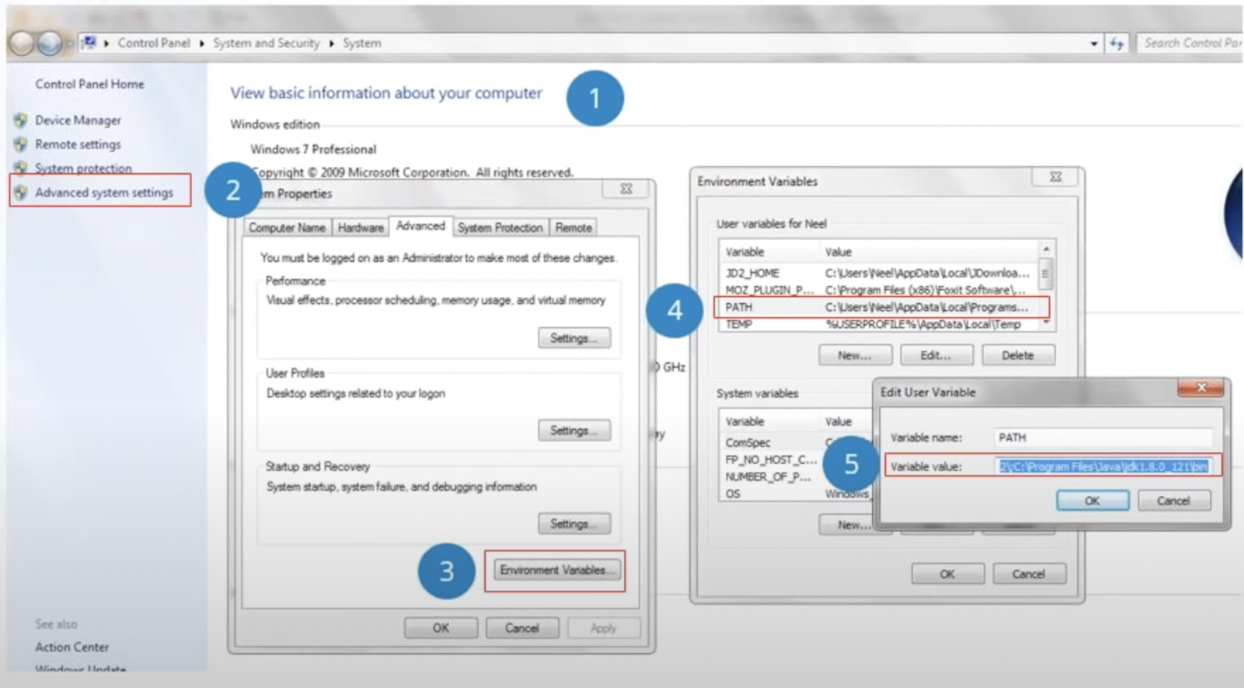
Java Installation
To set the permanent path of JDK in your system:
Begin by going to My Computer properties
Click on Advanced system setting.
Click on Environmental variable option
Select Path variable to edit
Enter the path to bin folder inside JDK installed in your system.

Slide 15
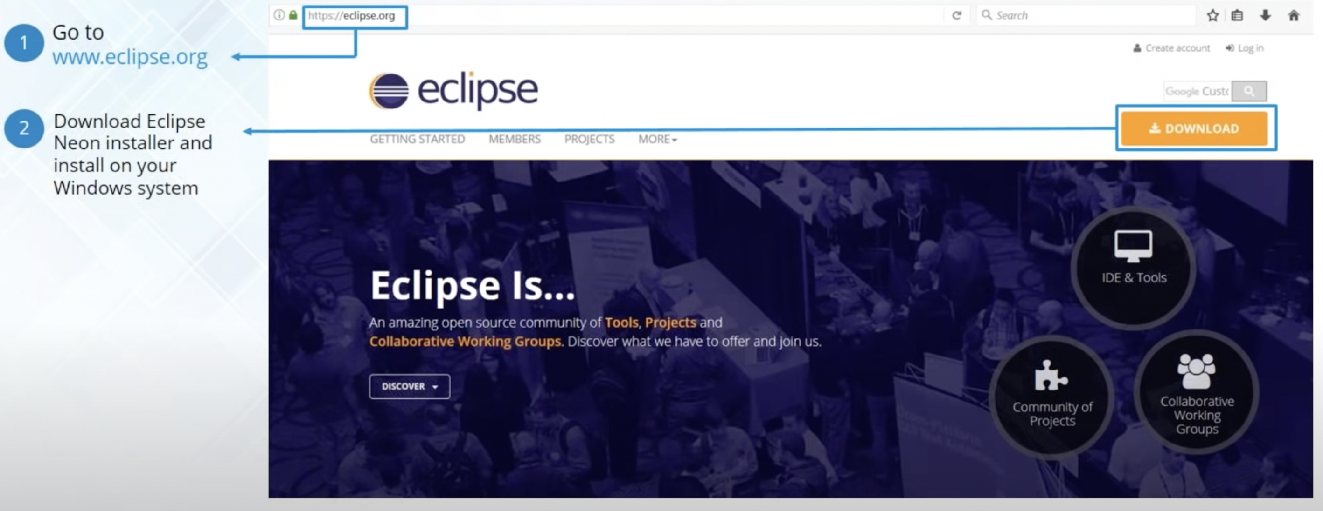
Eclipse IDE Installation

Slide 16
First Java Program

Slide 17
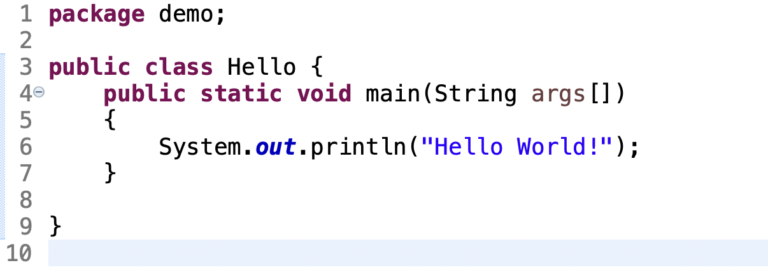
static is a keyword, if we declare a method as static , it is know as static method. The core advantage of static method is that there is no need to create object to invoke the static method.
public keyword is an access modifier which represents visibility, it means it is visible to all
String args [] is used for command line arguments.
class keyword is used to declare a class in Java
main represents the startup of the program
void is the return type of the method; it means it doesn’t return any value
System.out.println() is used for print statement

Slide 18
Variables & Datatypes

Slide 19
Variables
Variables are memory locations which are reserved to store values.
Local Variables
Created in a method or in a block
Variables
Static Variables
Belongs to the class
Instance Variables
Is an attribute of an object

Slide 20
Local Variable
Declared in methods, constructors, or blocks
Created when execution enters a method, constructor, or block
Visible only within the declared method, constructor, or block
Implemented at stack level internally
There is no default value for local variables, so local variables should be declared, and an initial value should be assigned before the first use

Slide 21
Instance Variable
Declared in a class.
When a space is allocated for an object in the heap, a slot for each instance variable value is created.
Created when an object is created with the use of the keyword “new” and destroyed when the object is destroyed.
Visible for all methods, constructors and block in the class.
Have default values. For numbers , the default value is 0, for Booleans it is false, and for object reference it is null.
Values can be assigned during the declaration or within the constructor.

Slide 22
Static Variable
Declared with the static keyword inside a class, but it is created outside a method, constructor, or a block.
Declared as constants i.e., variables never change from their initial value.
Stored in the static memory.
Created when the program starts and destroyed when the program stops.
Declared public since they must be available for users of the class.
Can be accessed by calling with the class name.

Slide 23
Datatypes
Each variable in Java has a specific type, which determines the size of memory, the range of values that can be stored and the set of operations that can be applied to the variable.
Datatypes can be categorized into two major types:
Primitive
Non-primitive/reference

Slide 24
Datatypes
Primitive
The datatypes which predefined by the language and named as a keyword.
There are 8 major Primitive Datatypes:
byte – number
short – number
int – number
long – number
float – float number
double – float number
char – a character
boolean – true or false
Syntax : int num=50;
Non-Primitive/Reference
Reference variables are created using defined constructors of the class.
These variables are declared to be of a specific type that cannot be changed.
Objects of various classes , Strings and Arrays comes under reference datatype.
Syntax: Student s1=new Student();

Slide 25
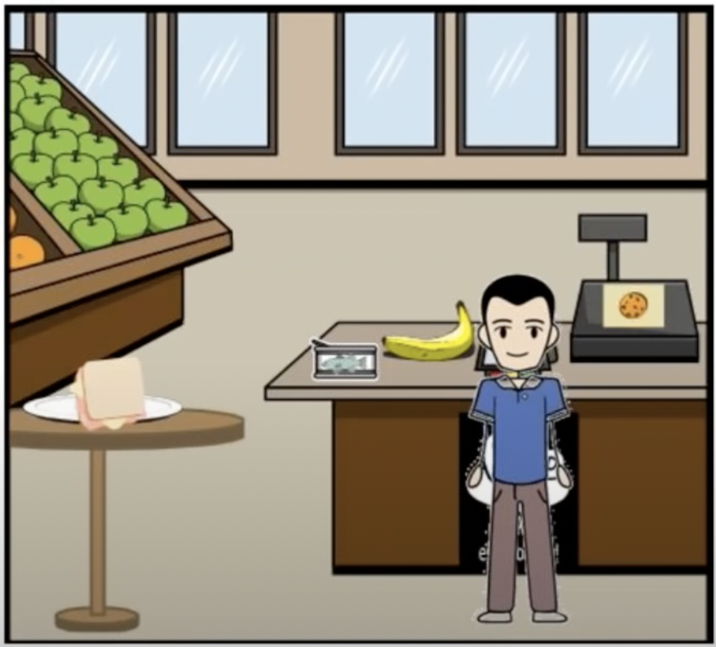
Datatypes
John own a Retail Department store. John needs to create a bill with the following field present:
Invoice ID
Product ID
Product Cost
Quantity
Discount
Total Price
Feedback Provided ?
John has no knowledge about the datatypes in Java,
Can you help John ?

Slide 26
Datatype Conversions
A datatype of a particular variable can be converted to other datatypes.
There are two ways in which we can perform Datatype Conversions:
Implicit Conversions
Explicit Conversions
The arrow in the diagram shows the possible Implicit Type casting that are permissible between Primitive Datatypes.
As the diagram shows int can be converted implicitly to long, float, double.
For vice versa, they have to be converted explicitly.
short
byte
int
long
float
double
char

Slide 27
Data Operations in Java
Data Operations
Relational Operators
Arithmetic Operators
Unary Operators
Logical Operators
< | → | Less than
<= | → | Less than or equal to
> | → | Greater than
>= | → | Greater than or equal to
!= | → | Not equal to
== | → | Equals
+ | → | Addition
- | → | Subtraction
* | → | Multiplication
/ | → | Division
* | → | Modulus
++ | → | Increment
- - | → | Decrement
&& | → | AND
|| | → | OR
! | → | NOT

Slide 28
Data Operations in Java
Let us assume the following values for the variables:
Num1 = 10
Num2 = 15
Num3 = 25
Num4 = true
Operations | Solutions
( Num1 + Num2 ) – Num3 / 5 | 20
Num1 ++ | 11
Num3 >= Num1 + Num2 | True
Num2 == Num1 | False
(Num2 < Num3 ) && ( Num1 > Num3) | False
!Num4 | False

Slide 29
Data Operations in Java
Mathew has come to John’s store to purchase a few products. Below are the items Mathew wishes to purchase:
Below are the cost of the products:
At the time Mathew visited the store, there was a 10% discount on all product.
Finally, a service tax of 5% is applicable on all products.
Can you help John compute the amount Mathew has to pay ?
Product | Quantity
Item A | 2
Item B | 1
Item C | 3
Product | Cost
Item A | 200
Item B | 75
Item C | 500

Slide 30
Programming Constructs

Slide 31
Programming Constructs
Ii.. else
Selection Statements
switch .. case
Control Statements
Iteration Statements
while
do.. while
for
break
Jump Statements
continue

Slide 32
Selection Statements

Slide 33
if statement
Syntax:
if (condition):
statements 1 ….
else
statements 2 ….
start
If it is raining ?
true
false
Take an Umbrella
Go Play Football

Slide 34
switch statement
start
Syntax:
switch (expression){
case value 1: Statement1
break;
case value 2: Statement2
break;
.
.
.
Outcome of toss
Head
true
Tom wins
false
Tails
true
John wins
false
Default
Invalid Input

Slide 35
Iteration Statements

Slide 36
Iteration statement
Loops Repeat Actions
A loop statement in java executes a set of statements until a specific condition is satisfied
Repeat things until the loop condition is true
while
do .. while
Execute once and then repeat things until loop condition id true
Repeat things till the given number of times
for

Slide 37
do while statement
start
Syntax:
do {
statements…
}while (condition is True)
Repeat
Execute Block
Check Condition
false
Exit Loop
true

Slide 38
while statement
Syntax:
while (condition is True)
{
statements……
}
start
Check Condition
false
Repeat
true
Exit Loop
Execute Block

Slide 39
for statement
start
Syntax:
for (initialization; condition; iteration)
{
statements……
}
Initialization
Check Condition
false
Repeat
true
Exit Loop
Execute Statements
iteration

Slide 40
break statement
start
Syntax:
break;
Repeat
Check loop Condition
false
true
Exit Loop
Check break Condition
true
false
Execute Block
Exit Loop

Slide 41
continue statement
start
Repeat
Syntax:
continue;
Check loop Condition
false
true
Execute Block 1
Exit Loop
Check continue Condition
true
false
Execute Block 2

Slide 42
Control Statement
Mary is a schoolteacher. She conducted the final exam for the year. The exam included the following subjects:
Since there are multiple students, she wanted to create an automated system that will take the marks for these subjects and provide a grade for the final score.
Below is the grade distribution:
Can you help Mary?
Mathematics | Chemistry | Physics | English | Computer Science
Percentage | Grade
Below 40 | Poor
40 - 59 | Average
60 - 79 | Good
80 – 89 | Very Good
90 + | Excellent

Slide 43

Thank You

